Slide 1
Infomages
Embedding Data into Thematic Images
Darius Coelho and Klaus Mueller
Notes:
Hello Everyone, I’m Darius Coelho and I will be presenting my work which was supervised by my advisor Klaus Mueller
This is Infomages and it about Embedding data into thematic images

Slide 2
What are Infomages?
Notes:
So let me start of by telling you what an infomage is

Slide 3
Infomages
Infomages are a type of infographic that consist of a data chart that is embedded into a thematic image.
Notes:
Infomages are a type of infographic that consist of a data chart embedded into a thematic image

Slide 4
Infomages
Infomages are a type of infographic that consist of a data chart that is embedded into a thematic image.
Notes:
For example this chart which represents data about the perception of wearing a burkha in a work place

Slide 5
Infomages
Infomages are a type of infographic that consist of a data chart that is embedded into a thematic image.
Designed by Peter Ørntoft
Notes:
Is embedded into an image of a woman wearing a burkha.
This graphic was created by Peter Ørntoft and it won an award at the Kantar Information is Beatiful awards.

Slide 6
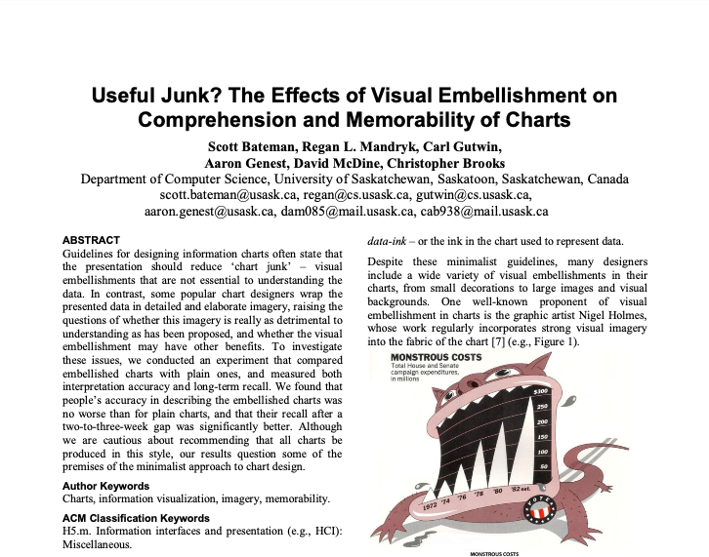
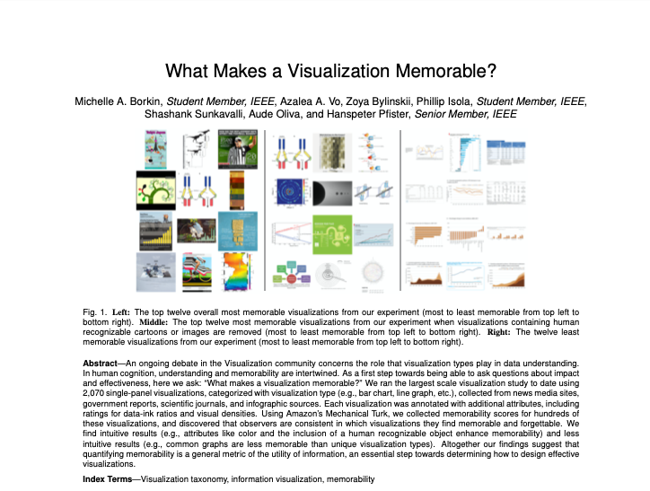
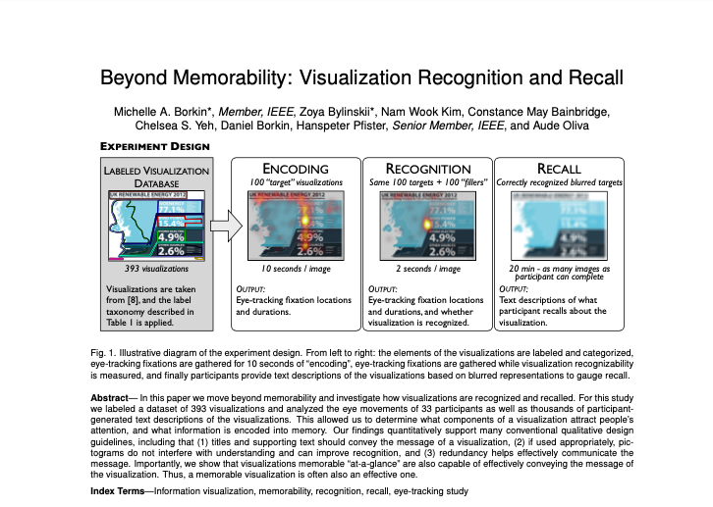
Why Infomages?
Gaining popularity
Base on previous studies, they can:
Engage viewers
Positively affect memorability
Difficult for casual users to produce
Harrison et al
Haroz et al
Bateman et al
Borkin et al
Borkin et al
Notes:
So why study infomages.
First, they have been gaining popularity and often appear in newspapers or blogposts.
Second, their properties have been shown to be beneficial by previous studies
They contain human recognizable objects and visual embellishments which have been shown to promote engagement by Harison et al and Haroz et al
These properties have also ben linked to improved memorability in studies conducted by Bateman et al and Borkin et al
However, these graphics are difficult to design and have mostly been produced by profession designers.
Our work aims to make the design of such infomages more accessible to novices by creating a novel design tool.

Slide 7
Infomage Survey
Notes:
But before creating our design tool, we first conducted a survey of existing infomages.
We wanted to first understand how professionals have gone about creating these graphics and then apply these principles to our tool

Slide 8
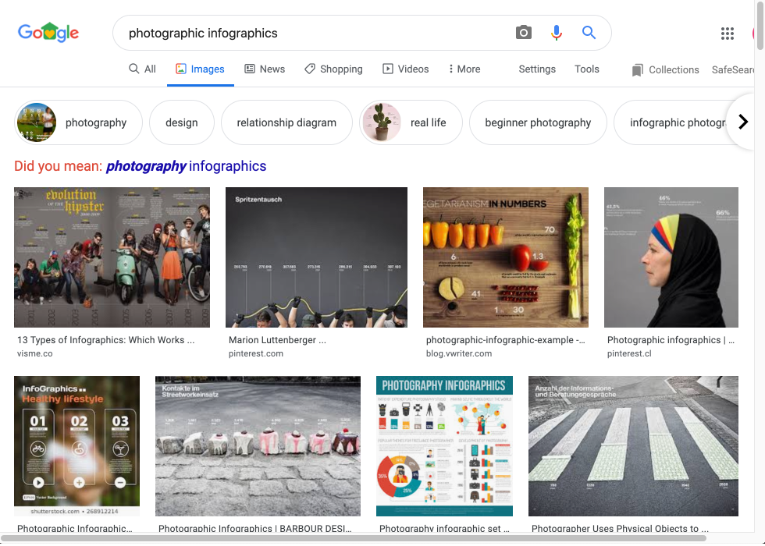
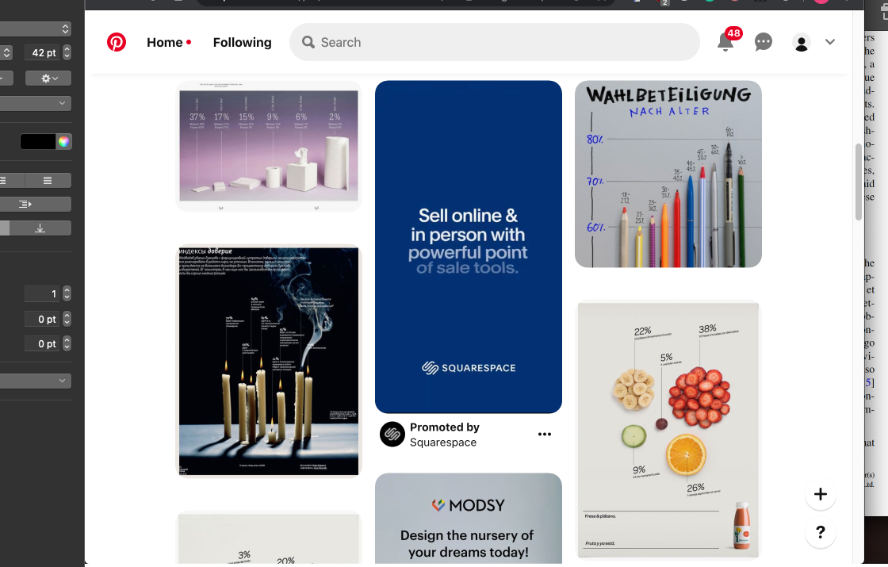
Infomage Survey
Photographic Infographic
Notes:
So we first collected a set of images for survey.
We used the term photographic infographic to retrieve infomage-like graphics using google images and pinterest.
We also used the `related images’ feature of these websites to recursively collect more images related to those in the initial result set.

Slide 9
Infomage Survey
1,638
Images
Notes:
We collected an intial set of 1636 images

Slide 10
Infomage Survey
224
Infomage-Like Graphics
Notes:
We then filtered images that did not fit the definition of an infomage leaving us with 224 Infomage-Like Graphics.
But it should be noted that we relaxed the condition for the image to be thematic so that we would have a larger set of images to study

Slide 11
Infomage Survey
224
188 created by Professionals
Notes:
We then used Google’s reverse lookup of images to see if we could identify the creators of these images.
We found that a large chunk, 188 of the 224 graphics were created by professional designers or design firms or were commissioned by magazines or newspapers

Slide 12
Infomage Survey
2 Coders
Chart Type
Embedding Method
Thematic
Notes:
We then coded each image based on the type of chart they used, the embedding method employed and if the image was thematic or contextual to the data

Slide 13
Chart Types
Bar
Pie
Single Divided
Multiple Resized
Line
Scatterplot
Others
Notes:
Let's look at the chart types first.
We categorized the graphics we collected into seven categories based on their chart type.

Slide 14
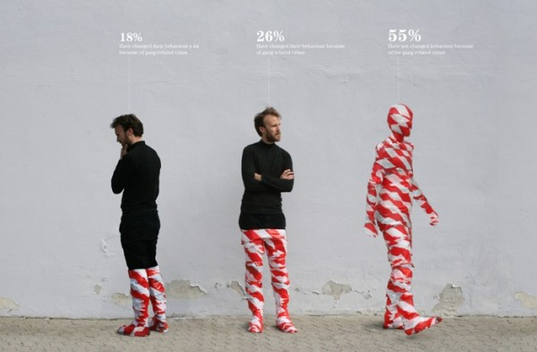
Chart Types
Bar
41.1%
Pie
Single Divided
Multiple Resized
Line
Scatterplot
Others
Designed by Peter Ørntoft
Notes:
The first and most popular is bar charts which were present in about 41% of the graphics.
Here image objects represented the bars in a bar or column chart, for example here a man represents the bars.

Slide 15
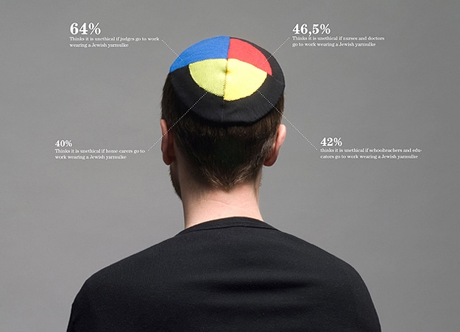
Chart Types
Bar
41.1%
Pie
21.4%
Single Divided
Multiple Resized
Line
Scatterplot
Others
Designed by Peter Ørntoft
Notes:
The second most popular was the the pie chart which was present across 21.4% of the graphics.
Here a pie chart is embedded into an image object, here this mans Kippah

Slide 16
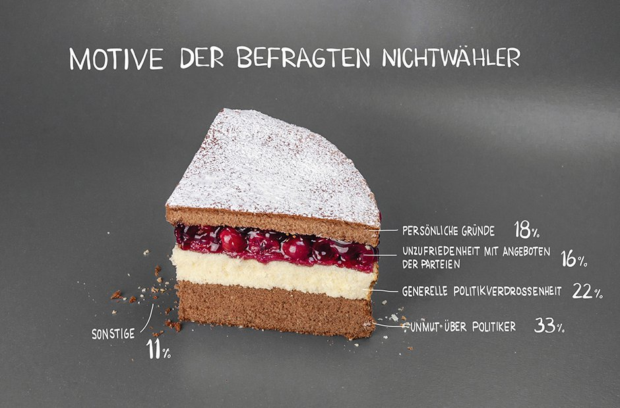
Chart Types
Bar
41.1%
Pie
21.4%
Single Divided
12.5%
Multiple Resized
Line
Scatterplot
Others
Designed by Anna Lena Schiller, Lisa Rienermann, and Sylke Gruhnwald for Zeit Online
Notes:
The next chart type is the single divided object with 12.5%. As the name suggests it is an image object that has been divided into multiple regions where the regions’ length or area represents a data value. In this case a the cakes layers represent the different regions

Slide 17
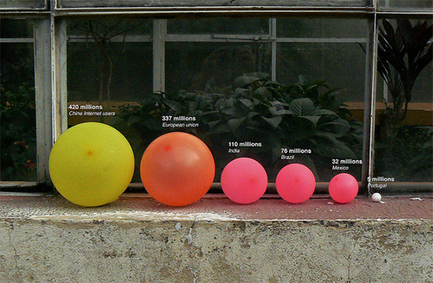
Chart Types
Bar
41.1%
Pie
21.4%
Single Divided
12.5%
Multiple Resized
11.2%
Line
Scatterplot
Others
Designed by Jose Duarte
Notes:
Next we have the multiple resized objects type which were present in 11.2% of the graphics.
Here multiple objects in the image are resized to represent data values. In this case multiple balloons of different sizes represent some data values.

Slide 18
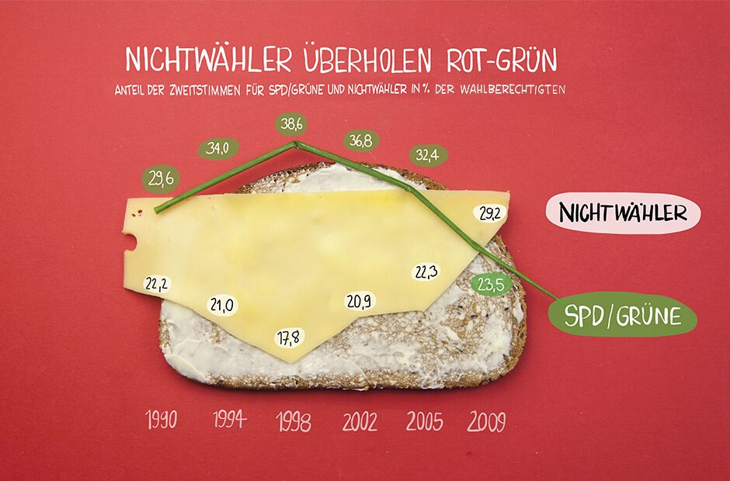
Chart Types
Bar
41.1%
Pie
21.4%
Single Divided
12.5%
Multiple Resized
11.2%
Line
9.4%
Scatterplot
Others
Anna Lena Schiller, Lisa Rienermann und Sylke Gruhnwald for Zeit Online
Notes:
Next 9.4% of the graphics consisted of line charts. Here an image object, like the green straw or edge of the cheese represents data values over time

Slide 19
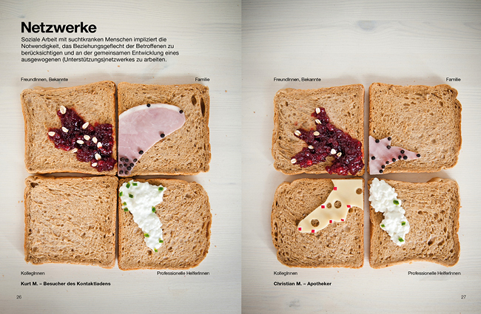
Chart Types
Bar
41.1%
Pie
21.4%
Single Divided
12.5%
Multiple Resized
11.2%
Line
9.4%
Scatterplot
2.2%
Others
Designed by Marion Luttenberger
Notes:
We also had a few scatter plots, 2.2 %, of the graphics, with various image objects representing points, axes and areas.

Slide 20
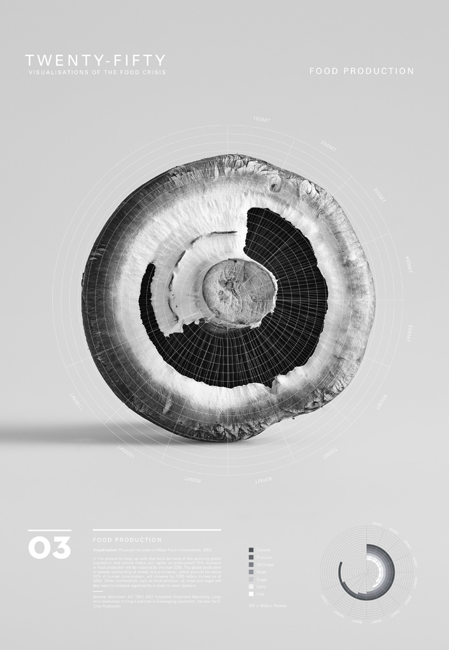
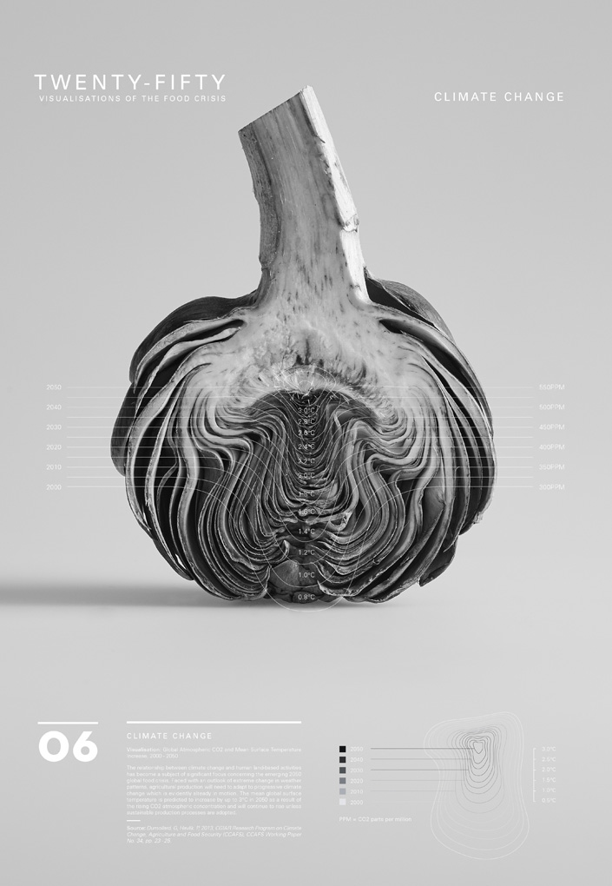
Chart Types
Bar
41.1%
Pie
21.4%
Single Divided
12.5%
Multiple Resized
11.2%
Line
9.4%
Scatterplot
2.2%
Others
2.2%
Designed by Twenty-Fifty
Notes:
Finally, all other visualizations such as sunburst charts or contour maps for which only one graphic was collected was put into the others category which contained 2.2% of the graphics.

Slide 21
Embedding Methods
Replicate and Transform
Fill
Overlay
Cutout
Notes:
Next, we categorized the graphics into four categories based on method used to embed the chart into the image.

Slide 22
Embedding Methods
Replicate and Transform
49.6%
Fill
Overlay
Cutout
Designed by Jose Duarte
Notes:
The first and most widely used technique is the replicate and transform which were present in about 41% of the graphics.
In this method an image object in replicated and then transformed by resizing it or reposition it. In this image we consider the balloons to have been replicated, repositioned to represent time and resized to represent data values.

Slide 23
Embedding Methods
Replicate and Transform
49.6%
Fill
29.5%
Overlay
Cutout
Designed by Peter Ørntoft
Notes:
Next we have the fill method which was employed by 29.5% of our set of graphics.
Here image objects are filled to represent data values. In this case the men in the image were filled to different with a texture to represent data values.

Slide 24
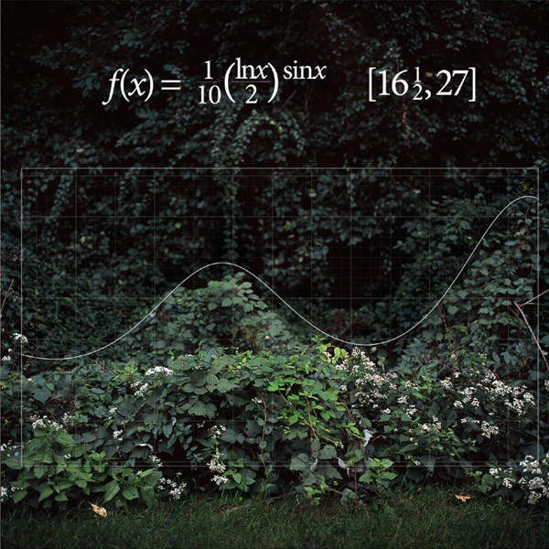
Embedding Methods
Replicate and Transform
49.6%
Fill
29.5%
Overlay
15.6%
Cutout
Designed by Nikki Graziano
Notes:
Next we have the overlay technique where the chart is overlaid on an image such that edges or objects in the background have a shape that is similar to the chart.
This method is employed in 15.6% of the graphics
Here the curve created by this mathematical function matches the curve produced by these plants in the image.

Slide 25
Embedding Methods
Replicate and Transform
49.6%
Fill
29.5%
Overlay
15.6%
Cutout
7.1%
Published by the Wall Street Journal
Notes:
The final technique we observed was the cutouts technique employed in 7.1% of the graphics.
This technique is straight forward, here the chart is used to cut out part of an image.
In this example a line or area chart was used to cut out part of an image.

Slide 26
Thematic
Thematic
52.6%
Not Thematic
47.4%
Designed by Peter Ørntoft
Designed by Anna Lena Schiller, Lisa Rienermann, and Sylke Gruhnwald for Zeit Online
Notes:
The final observation of our survey was that 52.6% of the graphics we collected used contextual while the others were not thematic.
For example this image is thematic since it shows data about what people think of wearing religious symbols at the workplace.
While this is not thematic as it uses a cake to show data related to reason for people not casting a vote in an election.

Slide 27
Infomage Design Tool
Notes:
Based on the what learnt from our survey we created an infomage design tool that allows users to create such graphics with relative ease.

Slide 28
Design Tool Overview
Image Retrieval
Data Embedding
Distortion Estimation
Post Processing
Infomage
Data File
Label Extraction
Fill Method
Distortion Computation
Image Filtering
Image Search
Overlay Method
Distortion Optimizer
Chart Styling
Font Styling
Notes:
So let me give you an overview of or tool’s workflow.
The user starts off by loading in a data file.
Our tool first retrieves images related to the data.
We do this by extracting the attribute labels as well as the name of the dataset and use this information to retrieve images from a search engine such as google images.
This process will yield incorrect results if the labels or dataset name is not semantically related to the data. For example if the attribute labels are x1 x2 and so on.
So we also allow the user to import an external image.
Once the images have been retrieved or the user imports an external image, the user moves on to the data embedding process.
The user can select from two of the surveyed embedding methods fill and overlay to embed the data into the image each method supports multiple chart types.
The embedding method often causes some chart distortion, thus the next step of our tool is distortion estimation.
Based on previous studies, we developed methods to compute the amount of distortion introduced to a graphic
We also developed methods to optimize the distortion.
Once the user is satisfied that the distortion is acceptable, he or she moves on to the post processing step.
This involves chart styling such as changing colors or adding glows to chart elements or filtering the background image as well as stying the fonts in the graphic to create the final infomage.
Due to the time limit, I will only discuss the details of our data embedding and distortion estimation method.

Slide 29
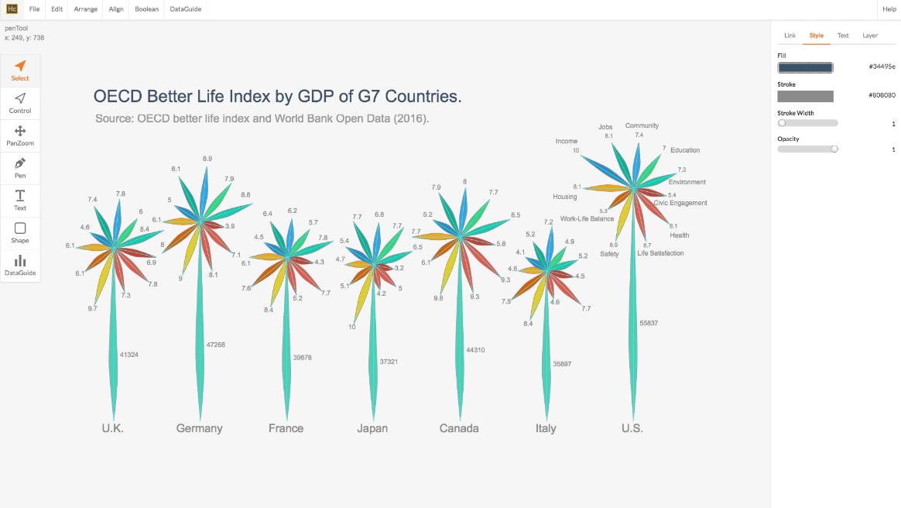
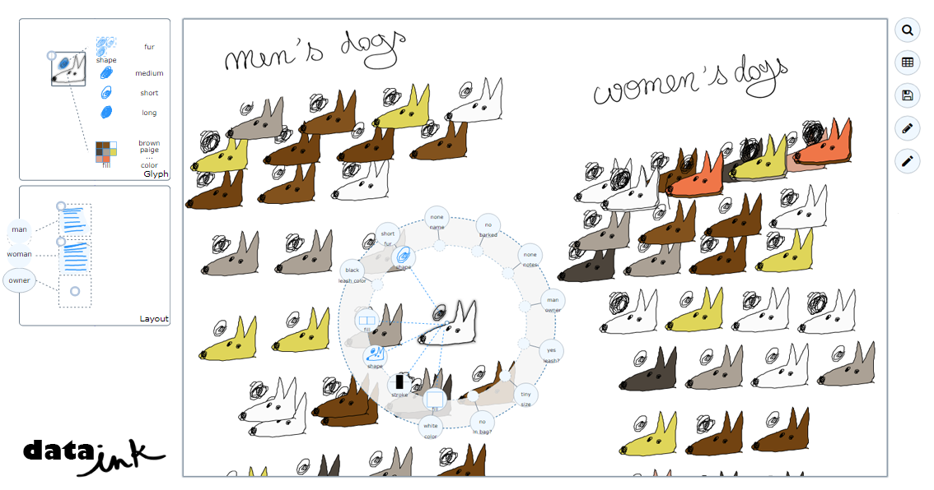
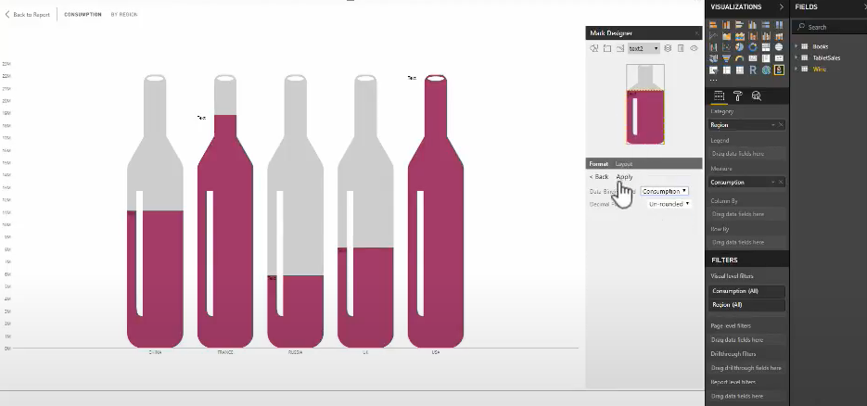
Embedding Charts
Fill
Overlay
Replicate and Transform
Cutout
Straight Forward
Not widely used
DDG - Kim et al
DataInk - Xia et al
InfoNice - Wang et al
Notes:
Lets start with the embedding techniques. We focus on the fill and overlay techniques in this work.
We exclude the Replicate and Transform technique has been well studied and implemented in tools such as DDG by kim et al, data ink by kia et al and info nice by wang et al
And the cut out technique is straight forward and was not very popular among designers.

Slide 30
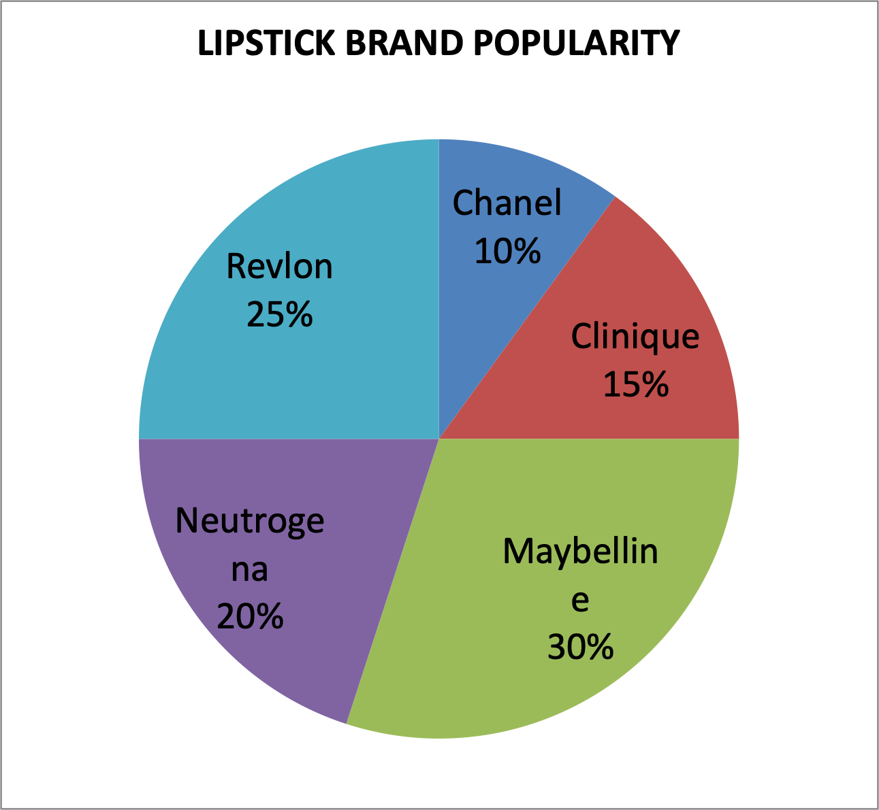
Embedding Charts: Fill
Notes:
So lets start with the fill method.
I will use this pie chart about lipstick popularity as an example to demonstrate our approach

Slide 31
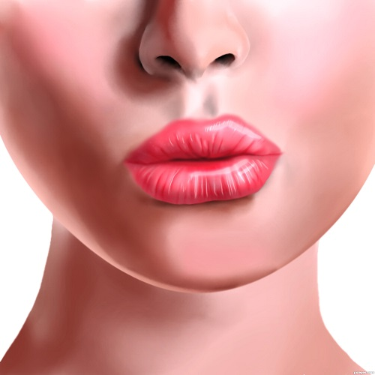
Embedding Charts: Fill
Notes:
Our tool retrieved this image of part of a woman’s face.
We can embed the pie chart into the woman’s lips.
To do this we must first segment out the lips.

Slide 32
Embedding Charts: Fill
Notes:
We do this with the Grabcut segmentation algorithm guided by the user.
Here the user draws a rough bounding box around an image area

Slide 33
Embedding Charts: Fill
Notes:
Optional markings can be used to mark the foreground and background to refine a segmentation if required.

Slide 34
Embedding Charts: Fill
Notes:
Using the markings grab cut generates a mask which can now be filled in with the chart and merged back into the original image.

Slide 35
Embedding Charts: Fill
Notes:
And generate the infomage

Slide 36
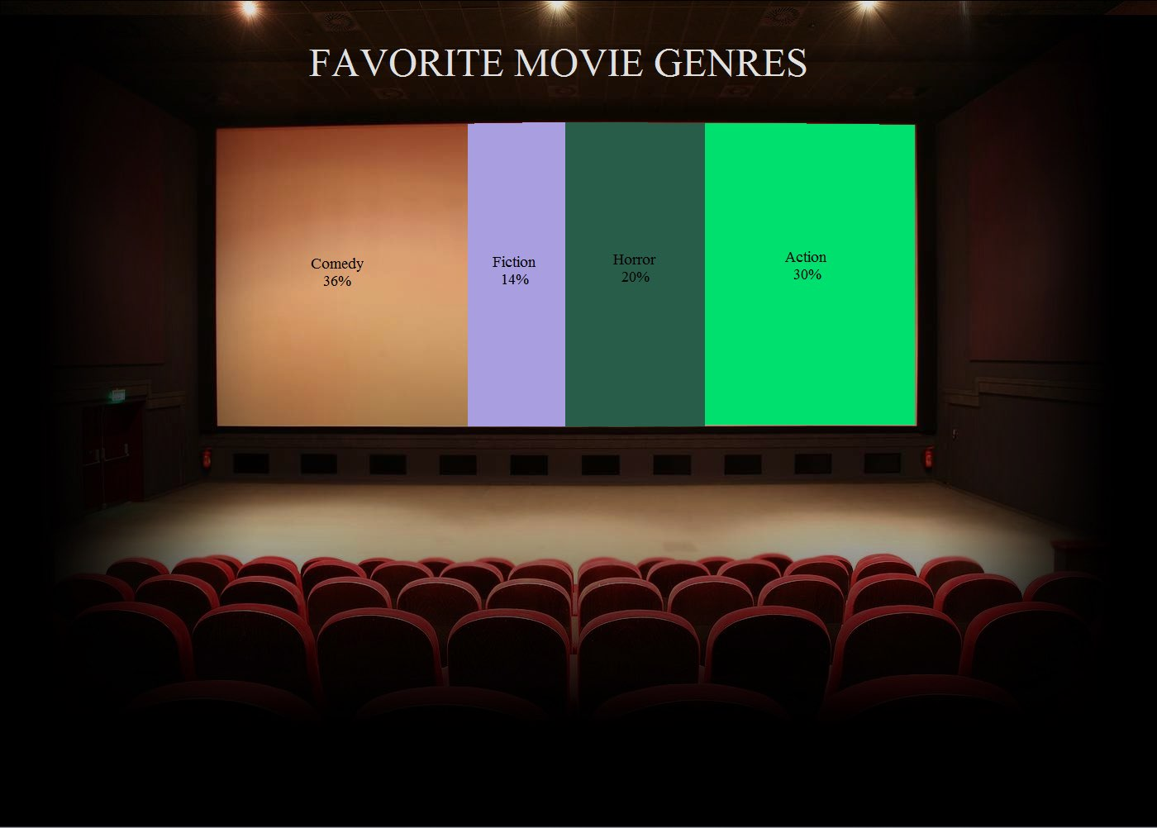
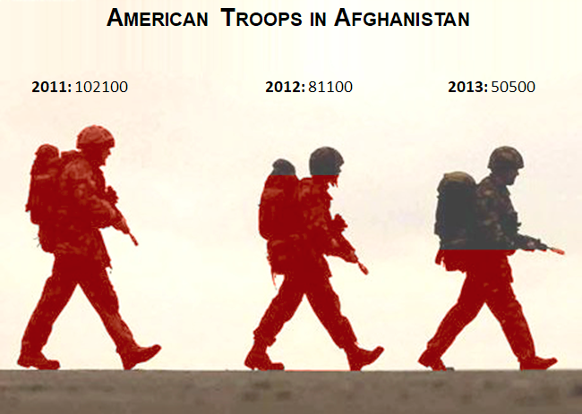
Embedding Charts: Fill
Notes:
Our fill technique can be used to support pie charts, the single divided objects filled along an axis or a bar chart.
In the pie chart the area can be divided based on the angle or area or arc length of each segment.
The single divided object and bar chart can be filled based on length or areas of the image objects.

Slide 37
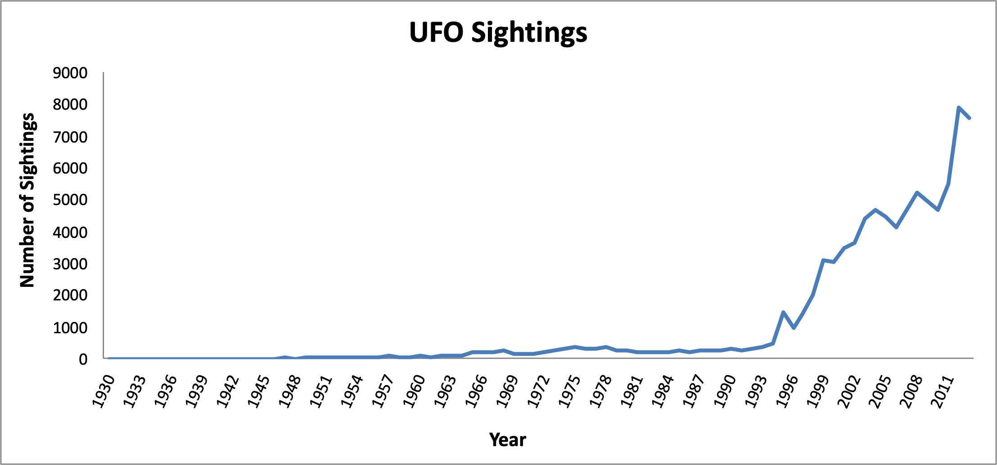
Embedding Charts: Overlay
Notes:
The other embedding method we support is the overlay method.
Here I will demonstrate this method with a line chart showing the number of UFO sightings reported over the years

Slide 38
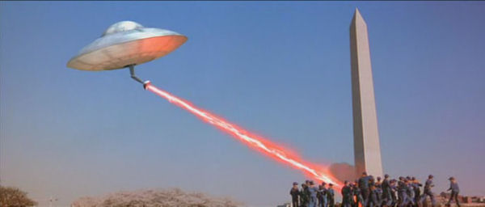
Embedding Charts: Overlay
Notes:
We can use this image go a flying saucer attacking earth for our infomage.
Now we have to determine a good position to overlay the line chart in this image.

Slide 39
Embedding Charts: Overlay
Notes:
We do this by detecting the hough lines in an image.

Slide 40
Embedding Charts: Overlay
Notes:
We then compute the regression line of our chart to represent the overall trend of the data.
We then find the hough line that has a slope that is closest to that of the regression line

Slide 41
Embedding Charts: Overlay
Notes:
We then use this hough line to determine the position of our chart by overlapping the centers of the hough line and regression line.

Slide 42
Embedding Charts: Overlay
Notes:
We then use this hough line to determine the position of our chart by overlapping the centers of the hough line and regression line.

Slide 43
Embedding Charts: Overlay
Notes:
We support line, bar and pie charts with this method.
For pie charts we find hough circles in the image.

Slide 44
Estimating Distortion
Fill
Overlay
Area / Angle / Length may not be proportional
Aspect ratio affects the perception of trend
Notes:
The embedding methods, especially the fill method adds some distortion to the chart.
Either the areas, angles or lengths of the segments may not match that of the proportions of original data.
And In the case of the overlay charts, the line chart or bar chart can be distorted by choosing an inappropriate aspect ratio or changin the range of the y-axis to the change the perception of the trend.
To avoid this we detect if the intersection of the x and y axes is 0 and if the average slope between lines is 45 as stated by the 45 banking rule.

Slide 45
Estimating Distortion
Fill
Overlay
Area:
18%
Slope:
8%
Angle:
0%
Origin:
0%
Arc Length:
11%
Avg:
9.7%
Avg:
4%
Notes:
To report this distortion
In fill charts we compute the difference between the plotted data by measuring the area, angles and length of segments in the infomage report the average difference across all segments as a percent error.
This error informs the user that on average their infomage may cause viewers to over or underestimate the data value of each segment by the reported percentage.
In the case of overlay charts we detect the if the intersection of the x and y axes is 0 and if the average slope between lines is 45 as stated by the 45 banking rule.
We also report the difference between the computed slope and offset of the origin as a percentage error.

Slide 46
Controlling Distortion
random_noise(data)
Simulated annealing for fill charts
Add random noise to data
Compute the distortion error
Accept lower error values
Accept higher errors sometimes
compute_distortion(image, data)
accept_error(area, angle, length)
Notes:
In addition to computing the distortion we also provide methods to optimize the distortion.
For fill style charts we optimize the distortion using the simulated annealing method.
This method basically varies the distortion until an optimal level is achieved
Here we add/subtract small random noise from the data values while ensuring their sum is equal to that of the original values
We then compute the chart distortion, that is the average error based on area, angle and length
If this error is lower than the previous error we accept the distortion,
We keep doing this until the change in error is extremely small for repeated iterations or if a decay function converges.
It should be noted that we also accept higher error values at random. This is done to avoid hitting local minimas

Slide 47
Controlling Distortion
Bank to 45 for overlay charts
$$M.R_{x}$$
$$α=$$
$$R_{y}$$
$$M$$
- Mean absolute slope between data points
$$R_{x}$$
- Range of x values
$$R_{y}$$
- Range of y values
Cleveland, W. (1993). A Model for Studying Display Methods of Statistical Graphics. Journal of Computational and Graphical Statistics, 2(4), 323-343
Notes:
To optimize the distortion in overlay charts caused due to the aspect ratio.
We compute the optimal aspect ratio by baking to 45 degrees using the Average-Absolute-Slope Banking method developed by Cleveland
The aspect ratio is approximated by this formula where M is the…..

Slide 48
Interface
Notes:
These methods are all packed into a windows based interface shown here.

Slide 49
Usability Study
Notes:
The final part of this work was a user study that tested our design tool.

Slide 50
Usability Study
5 participants
21 minute tutorial + practice
Two tasks:
Replication
Creation
Grad Students
Notes:
For the study we recruited 5 participants- 4 males and 1 female who were all grad students
They were first given a tutorial and allowed to practice interacting with our tool. On average this took them 21 minutes
Next, they had to perform two main tasks for the study.
The first was a replication task where they had to replicate one overlay chart and two fill charts a single object and multiple object fill chart
The second task was a creation task. They were given multiple datasets and the could select any dataset they liked and create an infomage of their choice with it.

Slide 51
Usability Study
4:49 Min
Replication
13:11 Min
Creation
Functionality
4.3 / 5.0
Easy to Use
4.6 / 5.0
Easy to Learn
3.8 / 5.0
Performed as Expected
Notes:
We studied three main aspects.
The first is the tools functionality
The participants took an average of 4 minutes and 49 sec to replicate a single infomage and 13:11 to create one from scratch
It should be noted that they spent more time with the overlay charts as those charts had more elements to play with during the post processing such as line or bar glows, axis formatting and more
Next we asked the participants to rate our tool usefulness with a 5 pt likert scale
They rated the tool as easy to use with an avg rating of 4.3
They also agreed that it was easy to learn with rating of 4.6
While they gave it a lower score when asked if it performed as expected.
They state that at times the segmentation was not accurate although it was easy to perform
They also stated that the placement of line charts was not perfect and appeared at locations they did not expect

Slide 52
Usability Study
Functionality
Distortion
“Understood what distortion values indicate”
“Did not know what level was acceptable”
Notes:
Second we asked the participants what they thought of the distortion estimation.
They all stated that they understood what the distortion values indicated
However they also stated that they did not know what level of distortion would be acceptable

Slide 53
Usability Study
Functionality
Distortion
Image Suggestion
“Liked image suggestion”
“Could do better on their own”
Notes:
Finally, the participants liked our image suggestion feature but stated that they could find better images on their own and the did so during the study.

Slide 54
Summary
Survey of existing infomage-like graphics.
Infomage design tool for novice users.
Methods to gauge the level of distortion as well as minimize it.
A user study that shows the usability our design tool.
Notes:
So to summarize, we conducted a study of existing infomage and based on what we learnt in the study we created a design tool that helps users easily create infomages as well as estimate distortion in these images. We also conducted a usability study that showed that in general users found the tool easy to use.

Slide 55
Limitations & Future Work
Defining a good level of distortion
Better image retrieval
More accurate embedding methods
Fully-automatic embedding method
Notes:
However this is a first step and there are several aspects that can be improved in the future.
The first is to somehow define a good level of distortion. This is an extremely difficult task and requires a large scale user study
Next is to develop better image retrieval as it is something that users pointed out
They also pointed out that our segmentation and alignment method could more accurate so that is something else that can be improved.
Finally, we hope to extend our embedding methods to a full automatic approach.

Slide 56
Infomages
https://github.com/darius-coelho/Infomages-Design-Tool
Darius Coelho
Klaus Mueller
Notes:
Thank you.

